Slide 1
Heterogeneity-Aware Cluster Scheduling Policies for Deep Learning Workloads
Presenter: Haochen Li, Yinsheng Zhou, Jingyue Shen

Slide 2

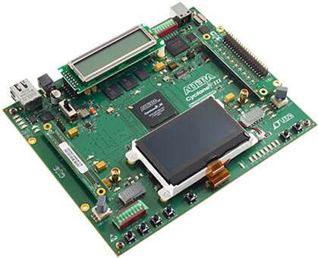
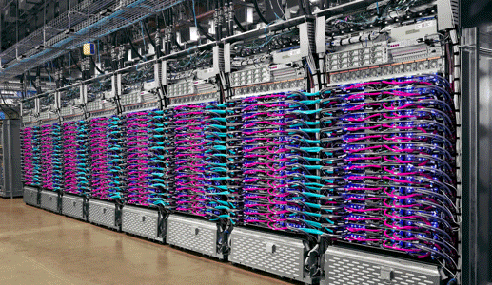
Introduction
Specialized accelerator has been increasingly deployed to train deep learning model.
GPU, FPGA, TPU
Resources in these multi-tenant settings are arbitrated by a scheduler.
For instance, GPU cluster scheduler such as Themis or Tiresias needs to decide how to allocate these resources to users.

Slide 3
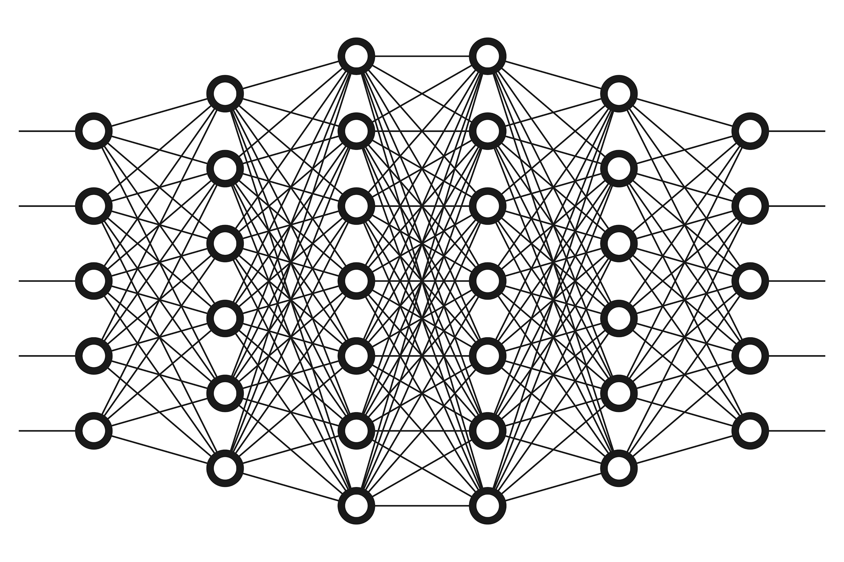


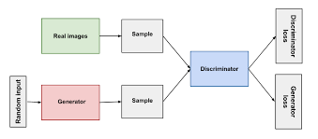
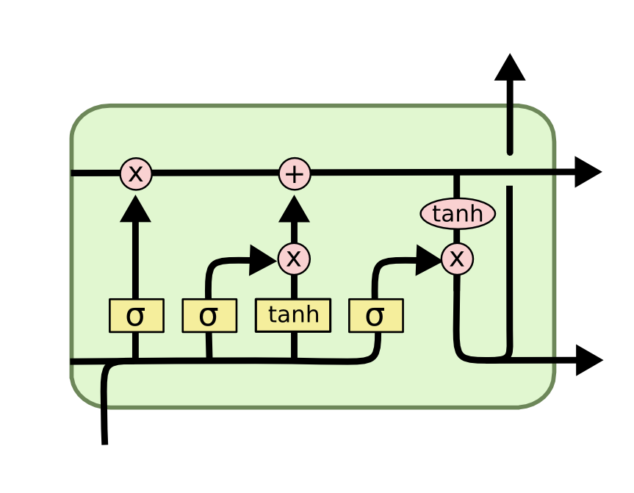
Using heterogeneous resources for training
Heterogeneous Clusters
Scheduler
How should we allocate heterogeneous resources for DL training jobs from multiple users while optimizing different objectives?

Slide 4
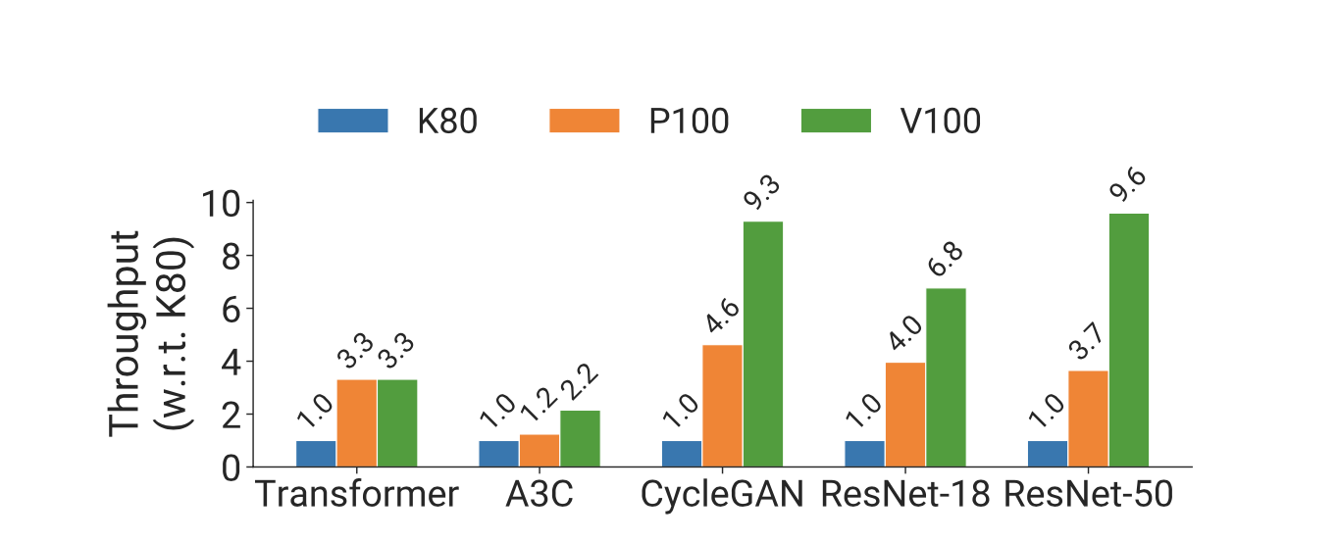
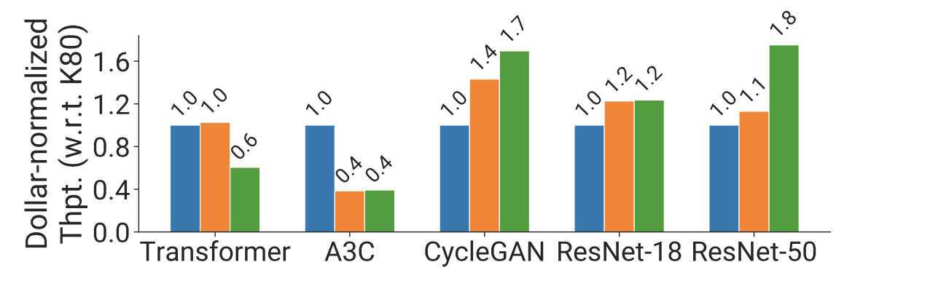
Difficulties - Performance Heterogeneity
Some DNN models showed different performance behavior using on different type of accelerator due to various architecture difference.
For instance, ResNet-50 performed better on Nvidia V100 GPU than performing on K80.
The “better” accelerators may not be optimal when considered in number of sample trained per dollar

Slide 5
Difficulties - Generality across Policies
Scheduler should support user-defined policies for optimization
For instance, cluster operator might want to optimize time to complete a set of batch job or optimize fairness for ad-hoc job
The two newly schedulers, AlloX and Gandivafair, could not support sophisticated policies that is used in practice.
Schedulers should optimize based on space sharing for improving cluster utilization.
Better placement of tasks within resource lead better scaling performance
These should be considered along with the global scheduling objectives.

Slide 6
Background
DNN is trained iteratively to suspend and continue training at iteration boundaries.
DNN scheduler could leverage this fact to multiplex jobs over physical sources.
Smaller models do not use the full computational capacity of GPUs.
Multiple models could be trained on single GPU for space sharing.
DNN models shows different scaling behavior
Different works needs to exchange tensors and the size of tensor would lead to different scaling behavior

Slide 7
Gavel - System Overview
A heterogeneity-aware scheduler which systematically generalizes a wide range of existing scheduling policies
For instance, Gavel can provide heterogeneity aware of fair sharing, FIFO or other policies.
Grave arbitrates cluster resource among different jobs while completing the desired objectives.

Slide 8
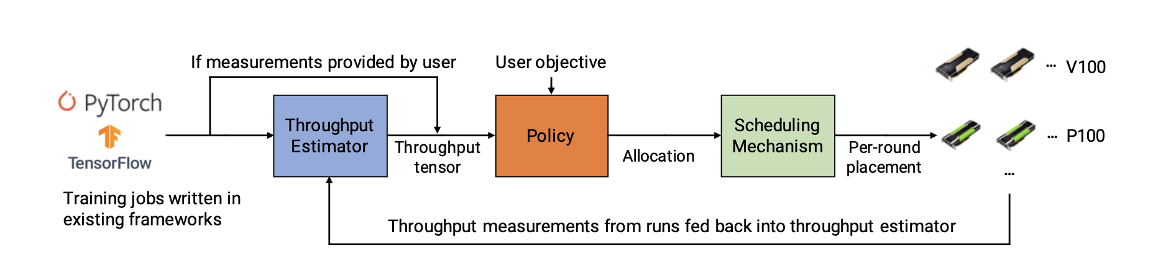
Gavel - System Overview (Cont.)
Gavel uses two-step processes:
Heterogeneity policy computes fraction of time that each job should run on a specific accelerator.
Input of policy is the performance behavior of each jobs, provided either by user or Throughput Estimator
Scheduling Mechanism will schedule jobs in different resources for different time based on the Policy output

Slide 9
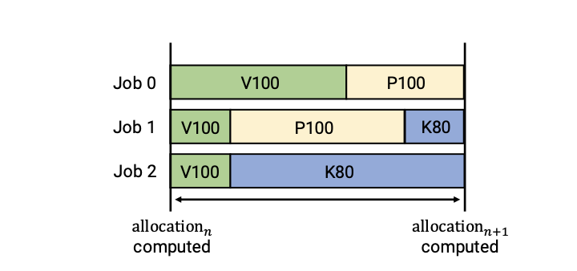
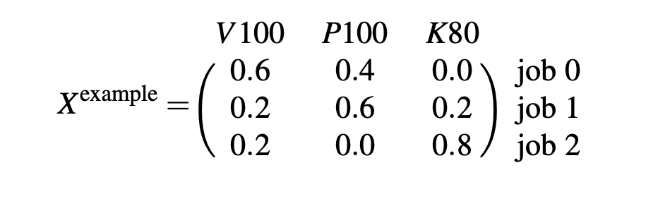
Heterogeneity Policy
Expresses scheduling as a optimization problem that is based on different objective
Markspan, fairness, etc
Expresses allocations as a matrix where each entry is represented as a fraction of time that a specific job should spend on a specific accelerator.
For instance, the X[0,0], in the figure below, represents that job 0 should spend 60% time on accelerator V100.

Slide 10
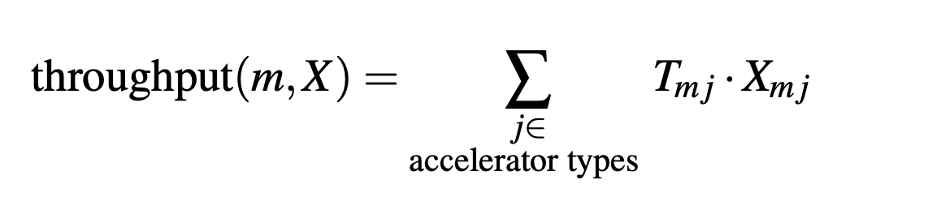
Heterogeneity Policy (Cont.)
Optimization problem: Given a policy/user objective, Gavel would find the optimal value for X (allocation matrix).
To solve this problem, Gavel needs a throughput matrix T that with each job’s throughput on each accelerator.
Entry would be -infinity if a specific job never run on a cluster
Given T and X, Gavel defines effective throughput of a model m as the timed-weighted average throughput across accelerators and jobs without space sharing.

Slide 11
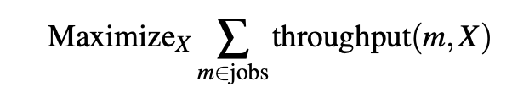
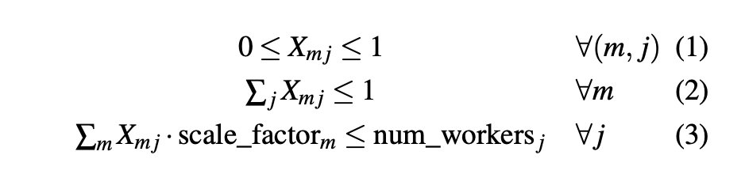
Heterogeneity Policy (Cont.)
After constructing the effective throughput, Gavel would proceed with computing the optimization problem by maximizing the effective throughput.
During optimization, it needs to follow the constraints below to ensure X is a valid allocation matrix.

Slide 12
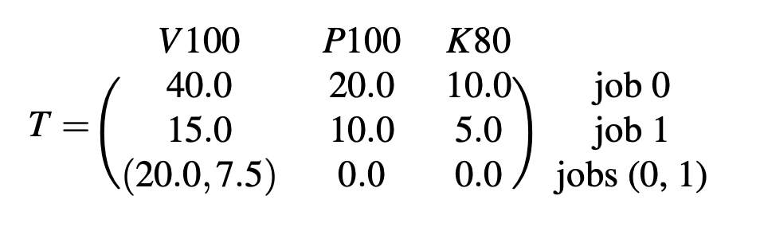
Heterogeneity Policy for Space Sharing
Gavel also incorporates space sharing.
By observation, pairs of DNN could perform differently when colocated together.
From this, Gavel would require extra rows in X defined for all combination of jobs and extra rows in T for all throughput of these combination jobs.

Slide 13
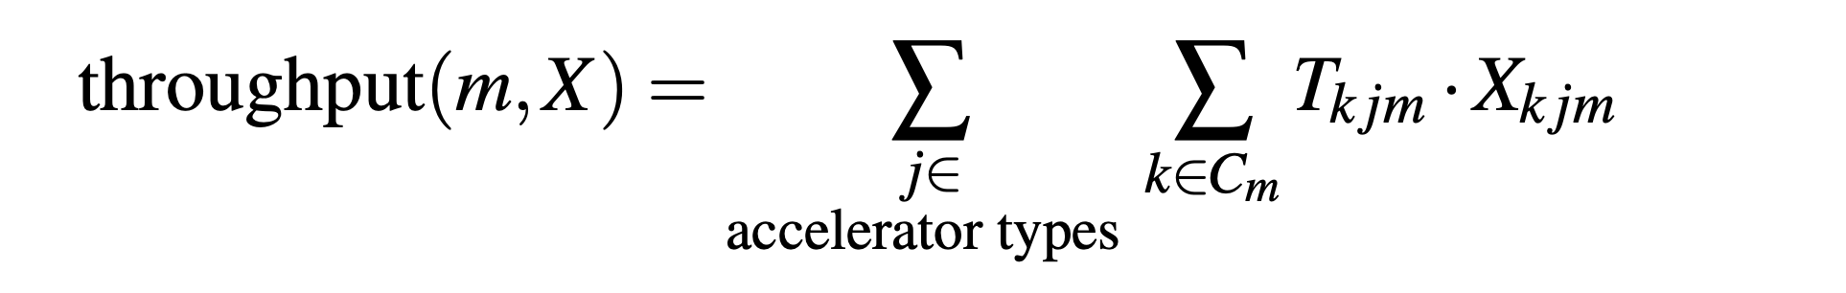
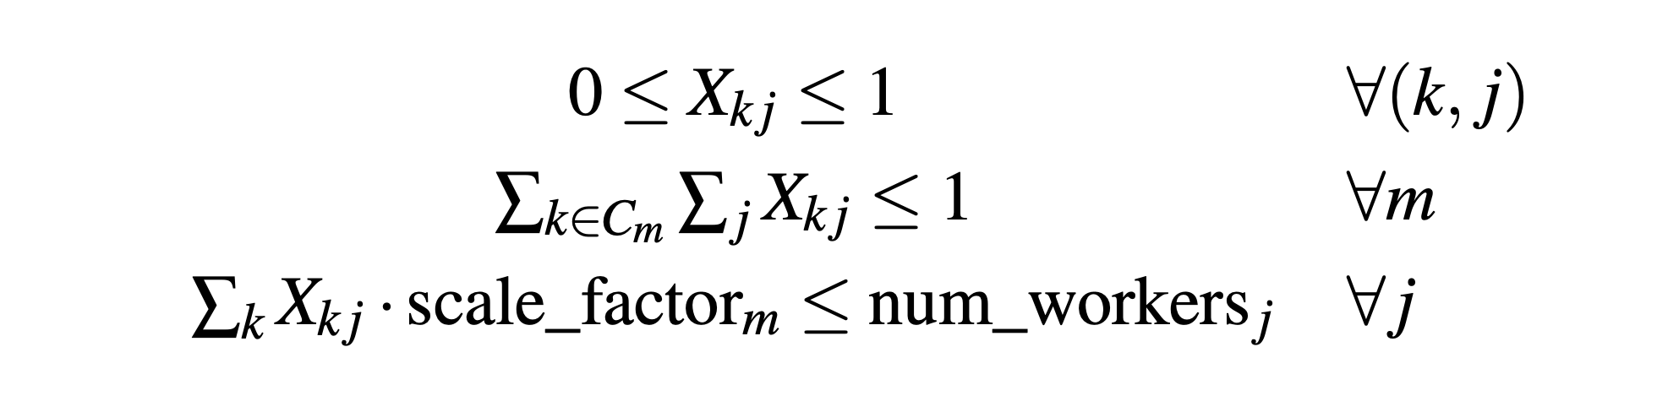
Heterogeneity Policy for Space Sharing (Cont.)
Therefore, in the optimization problem, Gavel would defined effective throughput for space sharing as following equation where combination of jobs have to be taken into consideration:
And the constraint would be modified as well:

Slide 14
Heterogeneity Policy for placement sensitive
By considering the performance of jobs in consolidated setting:
Number of accelerators within a server is large.
By considering the performance of jobs in unconsolidated setting:
Accelerators are on different independent servers.
These extreme points are upper and lower bound of performance.
This can be modeled into policies by having consolidated worker type and unconsolidated worker type.

Slide 15
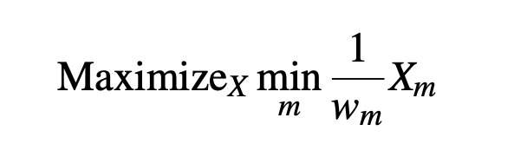
Scheduling Policies - Max Min Fairness
Most scheduling policies could be could be modified into optimization problem in terms of effective throughput.
The classical Least Attained Service (LAS) policy implemented Max Min Fairness in homogenous setting.
LAS would be expressed as a optimization problem with per-user weights w_m:
However, what about heterogenous setting.
If so, LAS policy is not fair anymore.

Slide 16
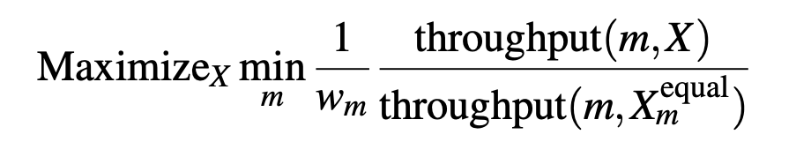
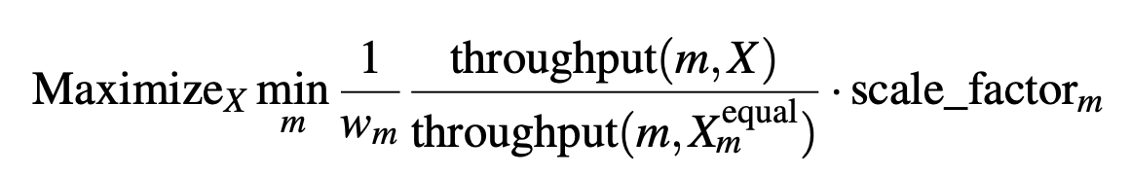
Scheduling Policies - Max Min Fairness (cont.)
In heterogeneous setting, max-min setting could be expressed over the weighted normalized effective throughputs:
X_m_equal represents equal time share of job m on each gpu within a cluster
For instance, if cluster have two accelerator, X_m_equal = [0.5, 0.5]
Scale factor could be easily incorporated for multi-resource jobs.

Slide 17
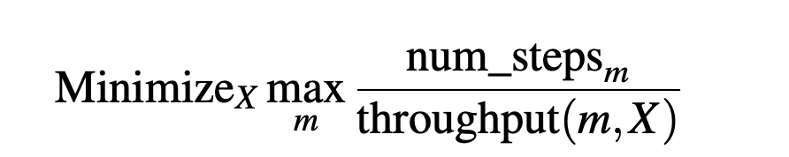
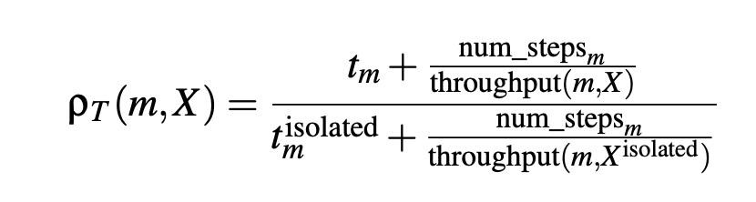
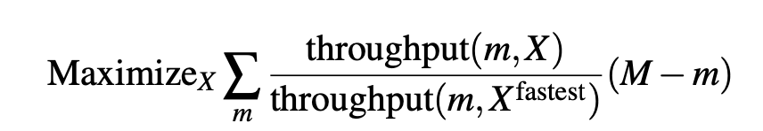
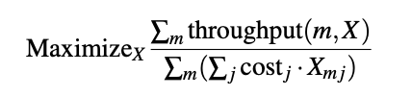
Other policies
Minimize Makespan:
Minimize Finish-time Fairness:
FIFO:
Minimizing Total Cost and Cost subject to SLOs:

Slide 18
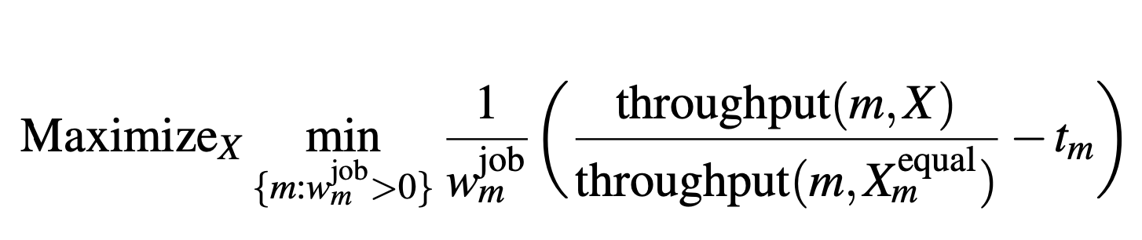
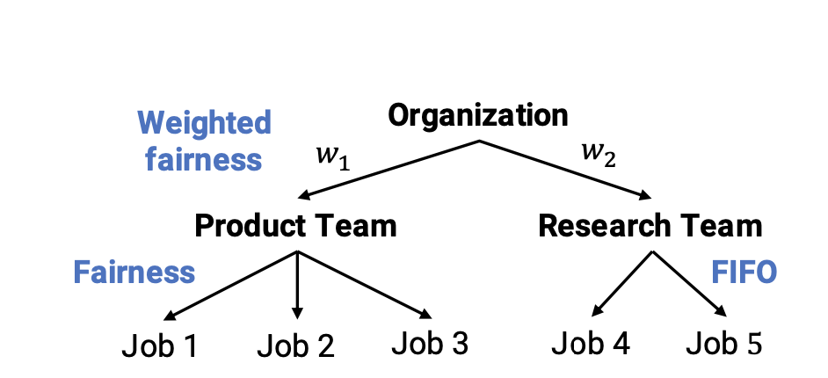
Hierarchical Scheduling Policies
Hierarchical scheduling policy is common for most cluster schedulers.
Large organization may share single physical cluster among many sub-organization
Gavel supports fairness in upper level and fairness or FIFO in lower level.
Gavel uses water filling algorithm to accomplish the hierarchical objective.
Increase equal rate for all parties at each level until one get saturated.
Then it will remove the saturated one and keep performing this until all parties are saturated.
Gavel adapt this procedure and solve a series of optimization iteratively:
Solve modified LP:
T_m: normalized effective throughput in previous iteration
MILP identify bottleneck jobs and ignore them for future scheduling. For instance, weights of job 4 will be assigned to job 5 if job 4 is bottlenecked.

Slide 19
Properties of Gavel Policies
Homogeneous cluster: Gavel’s heterogeneous-aware optimization problem would be reduced by having only one accelerator type.
Sharing incentive: Allowing each job to have 1/n usage of each resource is feasible solution of Gavel’s optimization problem.
Colocation: the solution with colocation is same as or better than the solution without colocation
Pareto Efficiency: water filling algorithm ensure that increasing performance of one job would not decrease performance of other jobs.

Slide 20
Scheduling Mechanism
Goal:
Assign jobs to accelerator types to match the optimal allocation X^{opt}
Method:
Perform scheduling in rounds - to prevent starvation and recourse under-utilization
Compute priority score for each job on each accelerator

Slide 21
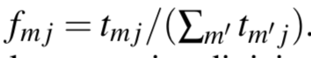
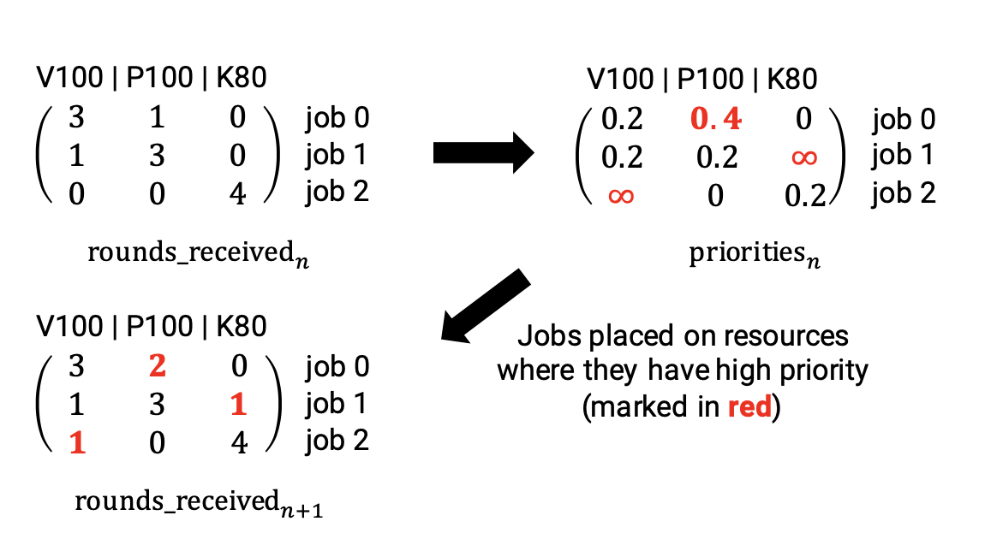
Scheduling Mechanism
In each round:
compute the fraction of time spent by each job on each accelerator type j
Calculate total time t_{mj} spent for each job m on each accelerator type j
Choose the job with highest score to run for each accelarator
Calculate priority score (element-wise division, X^{opt} / f)

Slide 22
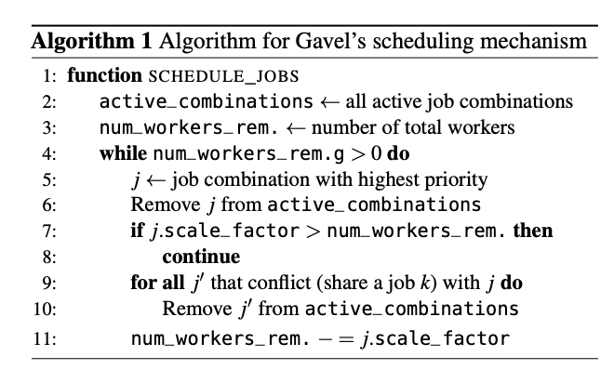
Scheduling Mechanism (Cont.)
Use greedy sub-optimal scheduling decisions to approximate
Picking a optimal decision is a NP-hard problem.
pick highest-priority job combination greedily within resource budget
Highest-priority job
(eligible_zjob_combinations)
(job_combinations_to_schedule)
Remove conflicting job combination
Remove j.c. due to space limitation

Slide 23
Evaluation
Question to answer:
Do Gavel’s heterogeneity-aware policies improve objective metrics in a physical cluster & simulated large clusters?
How do Gavel’s policy scale?

Slide 24
Evaluation
Experiments set up:
2 types of clusters:
Physical clusters: 8 V100s, 16 P100s, 24K80s.
Simulated large cluster: 36 GPU of each type
2 traces:
static - all jobs available at start
continuous - jobs are continuously added, in 1 - 30 days span
Metrics:
Job completion time (JCT)
finish time fairness (FTF)
time to complete a batch
cost

Slide 25
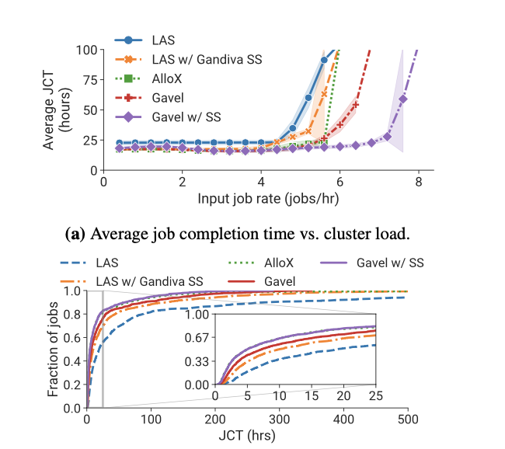
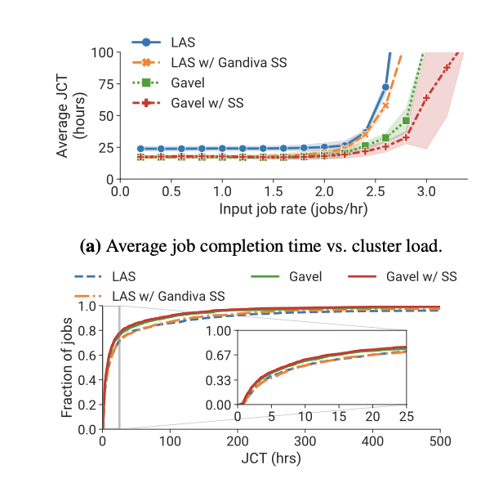
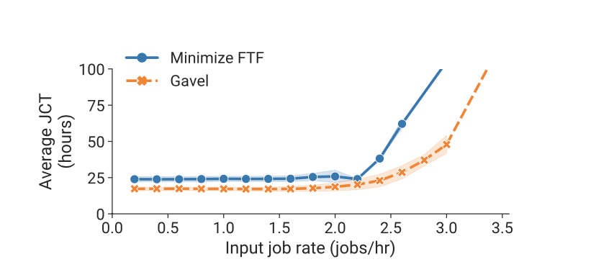
Evaluation - Performance
LAS: reduce average JCT by 3.5x.
FTF: reduces average JCTs by 3x and improves average FTF by 2.8x
Makespan: reduces makespan by 2.5×/1.4x compared to different baseline

Slide 26
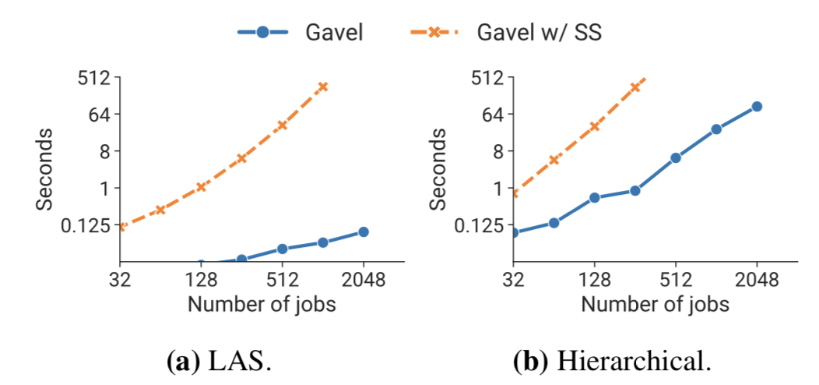
Evaluation - Scalability of policies
Even with 2048 active jobs, hierarchical policy could run less than 10 minutes

Slide 27
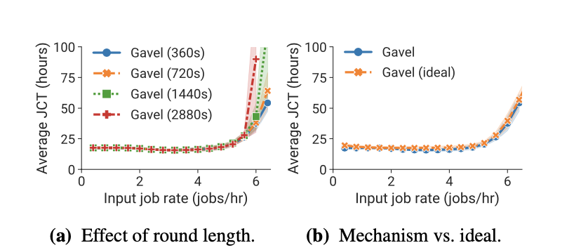
Evaluation - Efficiency of scheduling mechanism
a round length of 6 minutes gives a good tradeoff between fidelity with the optimal allocation and preemption overhead

Slide 28
Reference
Original paper presentation: https://www.usenix.org/sites/default/files/conference/protected-files/osdi20_slides_narayanan.pdf

Slide 29
Thank you!

